Slide 1

Pugin Hall’s Christmas Reception Menu
All Inclusive Reception @ €27pp
Mulled Wine and Hot Apple Spiced Punch
(one glass per person allocated)
Christmas Canopes
-Smoked Salmon with Cream Cheese
- Cocktail Sausages
- Savoury Mini Canopes
Includes onion cake, smoked duck breast with bitter orange; blini, horseradish and lemon cream, marinated anchovy, pink peppercorn, dill; caramel biscuit, cream mix with foie gras, fig jelly; pepper cake, shellfish-flavoured cream, marinated crayfish.
- Vegetarian Canopes
Japanese Style Burger, Club Sandwich, Onion Cakes & Mascarpone, Tomato Financier & Mozzarella, Blinis and Prepper cream, Spinach cake & Mascarpone.
- Mini Bouche Delights
Salmon and dill, cauliflower and broccoli, tomato goat’s cheese and basil, tartiflette, mushroom garlic and parsley
- Mini Mince Pies

Slide 2

Pugin Hall’s Christmas Reception Menu
Mulled Wine and Hot Apple Spiced Punch Reception
(sold in multiple of 10’s only) - €6.40pp
Mini Mince Pies (2) & Cream €3pp

Slide 3
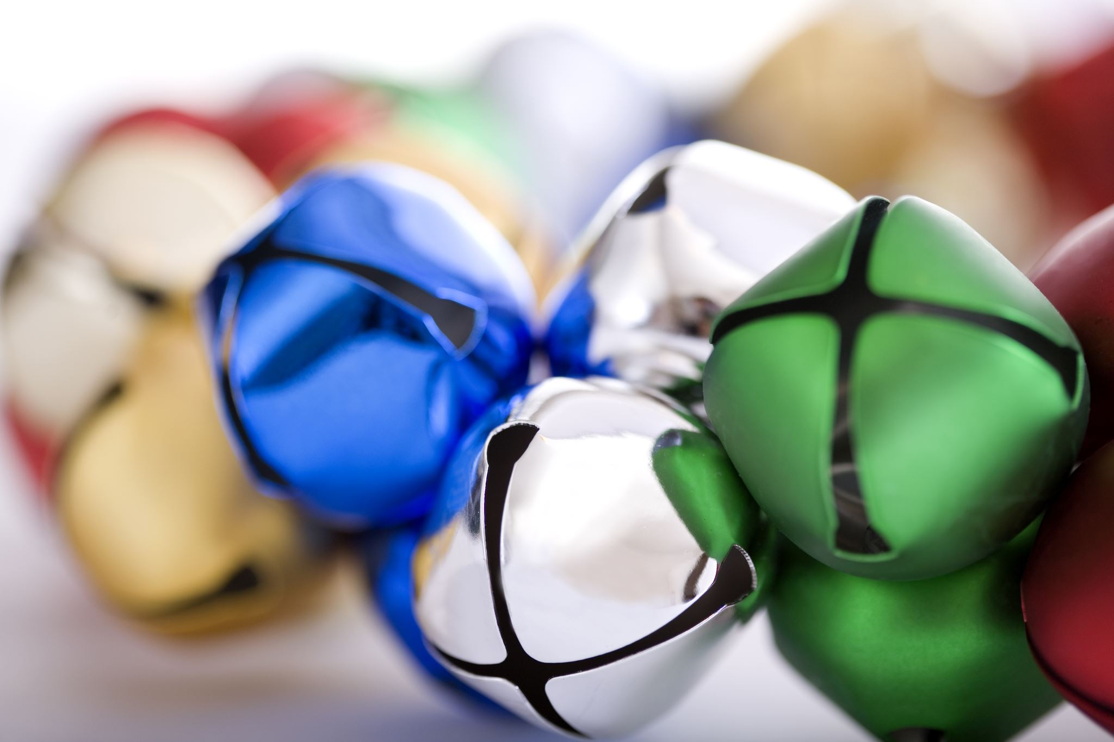
Pugin’s Christmas Buffet
(Tables fully dressed in Seasonal Colours with Added Christmas Crackers)
Minimum of 30 Guests, €42pp
Smoked Salmon, Creamed Horseradish, Mini Capers & Peppered Rocket
(Melon Balls with Fresh Mint and Orange Segments available for vegans & vegetarians)
***
Choice of Roast Irish Turkey & Ham or Nut Roast, with Herb Stuffing, Roast Potatoes & Brussel Sprouts
***
Mince Pies or
Christmas Pudding
***
Tea/Coffee

Slide 4
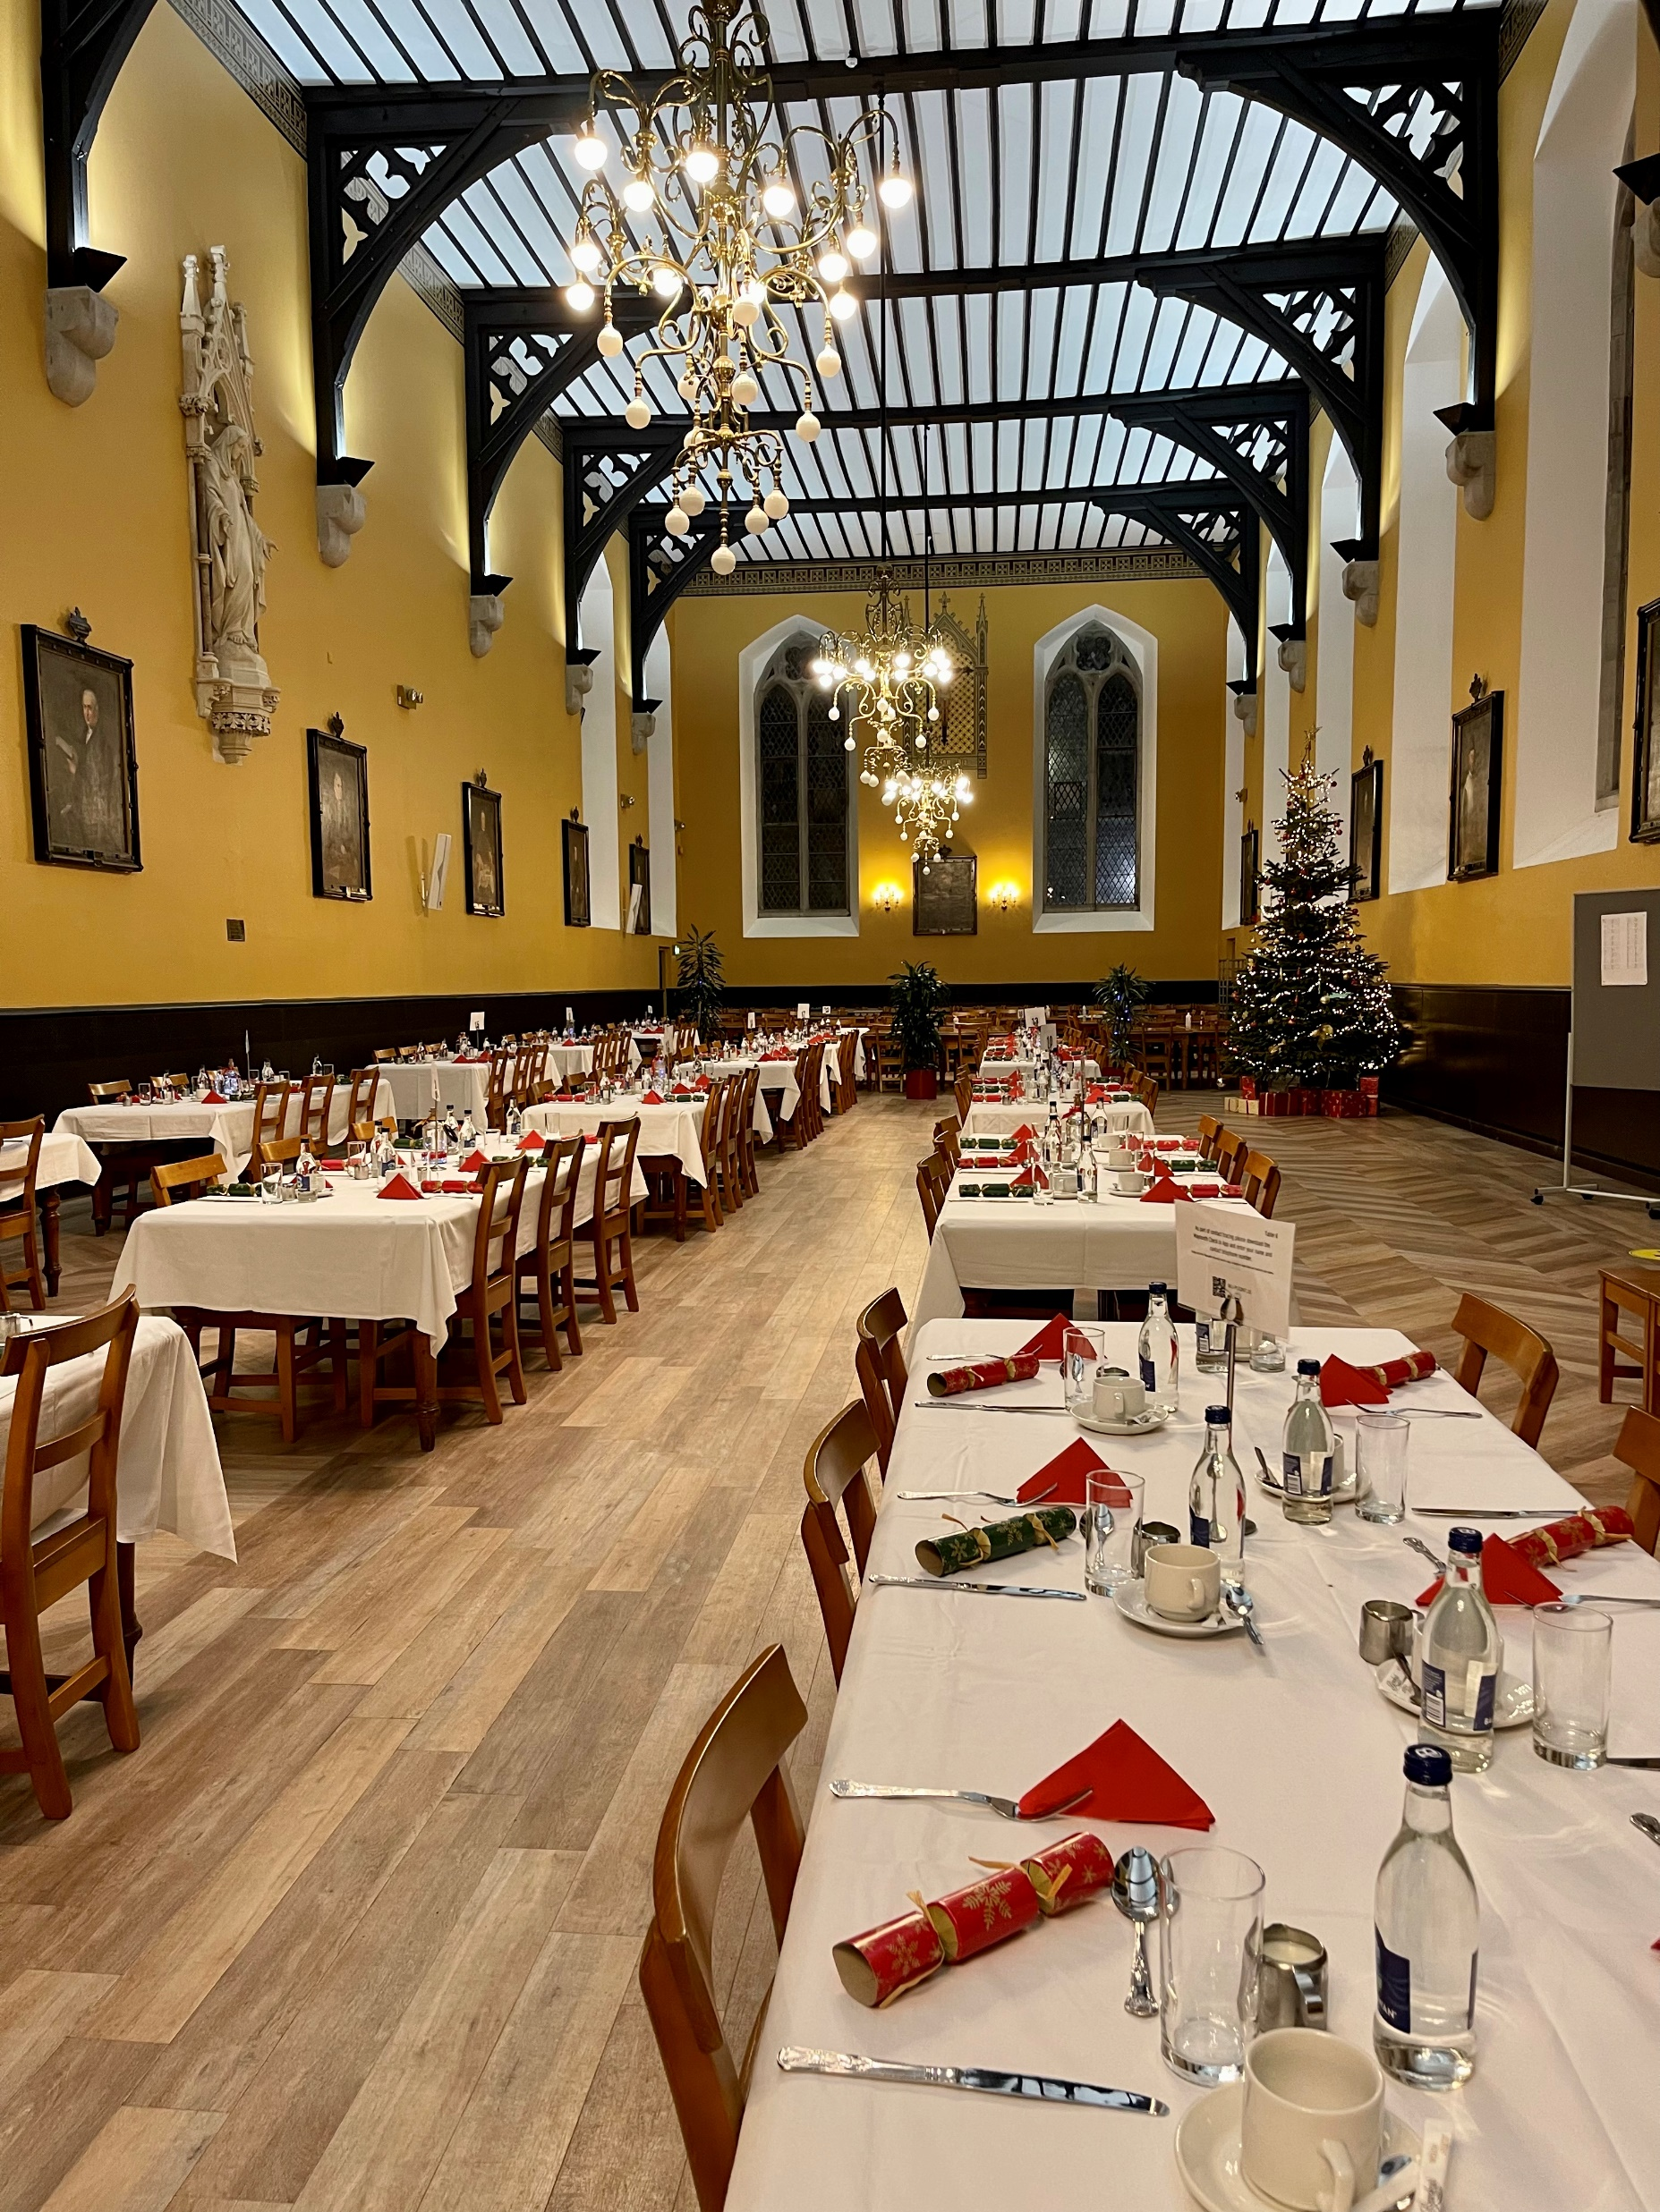
Pugin’s Famous Christmas Lunch
€23pp
Join us again this year for our Famous Annual Christmas Lunch with live appearance from Santa, four course self-service meal and a glass of wine!
Tickets available from mid -October, at the cash desks, or reserve by emailing catering@spcm.ie
Date: Monday 15th December, from 12pm-1.30pm

