Slide 1
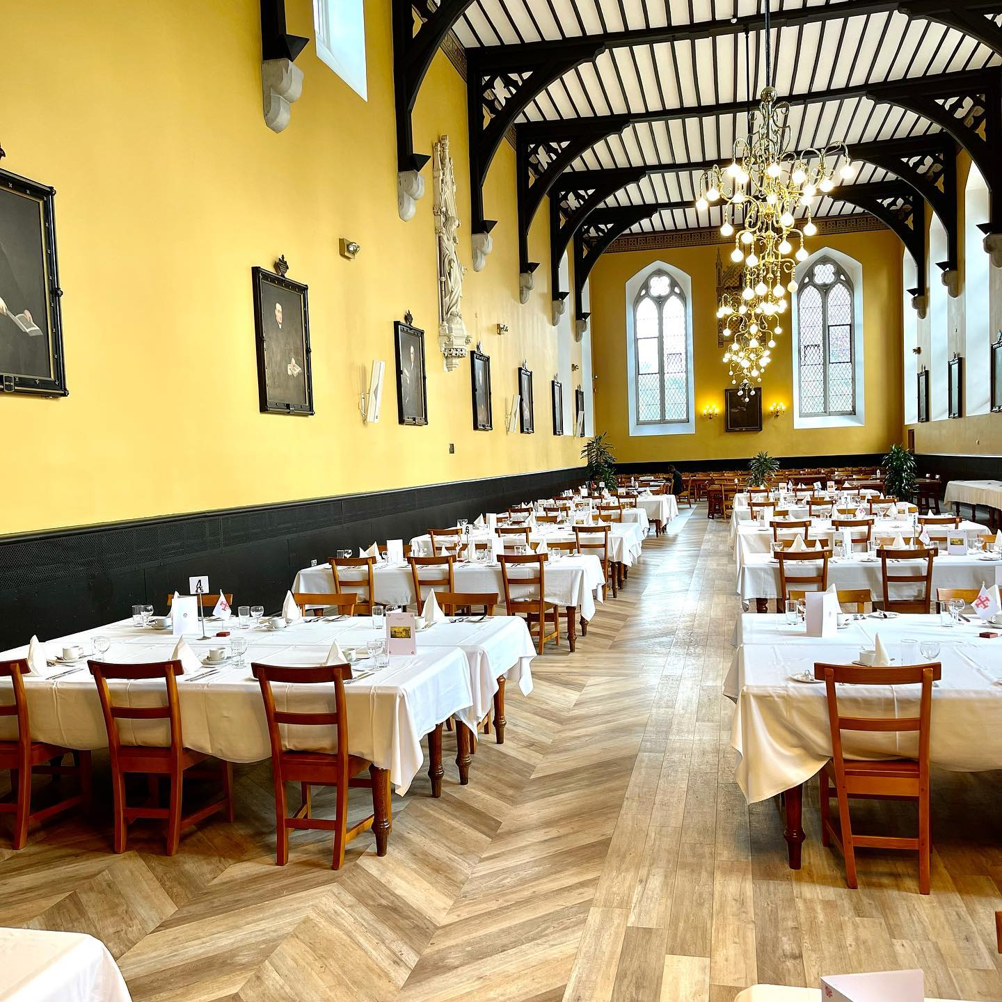
Pugin Hall
Hospitality Brochure
Academic Year 2025-2026
We are delighted to invite you to browse through our hospitality options, served in the beautiful and historic Pugin Hall Maynooth. Some options are also suitable for delivery on the South Campus.
Please contact events@mu.ie for all your conference needs, or fill out our booking form for non-conference internal department bookings
All dietary requests must be completed on the booking form, and in addition, will be displayed for your guests on the day. For that reason, they are not included on this brochure.
PUGIN HALL MAYNOOTH, SOUTH CAMPUS, ST PATRICK'S PONITIFICAL UNIVERSITY , MAYNOOTH, CO KILDARE W23 TW77
PH: +353 1 7083602
EMAIL: catering@spcm.ie
https://cateri78.wixsite.com/puginhallmaynooth
Notes:
1

Slide 2
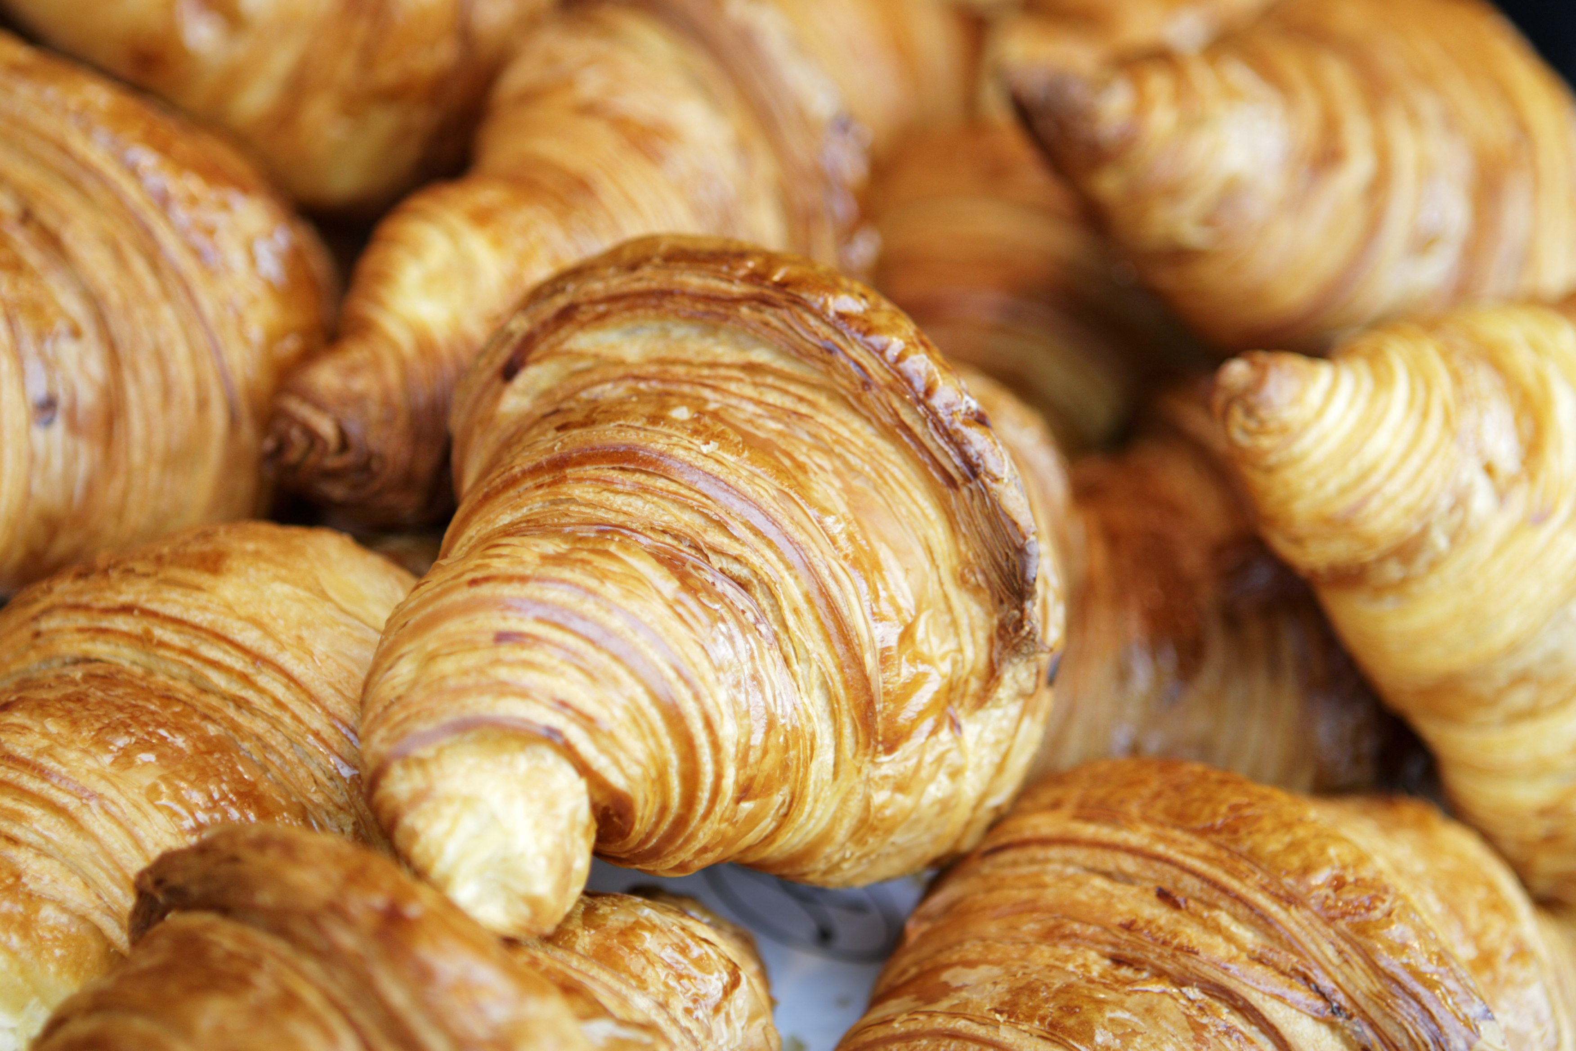
College Breakfast
€10.40
Includes:
Cereal
Toast
Porridge
Boiled Eggs
Sausage Roll
Selection of Warm Danish Pastries
Selection of Juices
Fresh Fruit Salad
Tea & Coffee
PUGIN HALL MAYNOOTH, SOUTH CAMPUS, ST PATRICK'S PONITIFICAL UNIVERSITY , MAYNOOTH, CO KILDARE W23 TW77
PH: +353 1 7083602
EMAIL: catering@spcm.ie
https://cateri78.wixsite.com/puginhallmaynooth

Slide 3

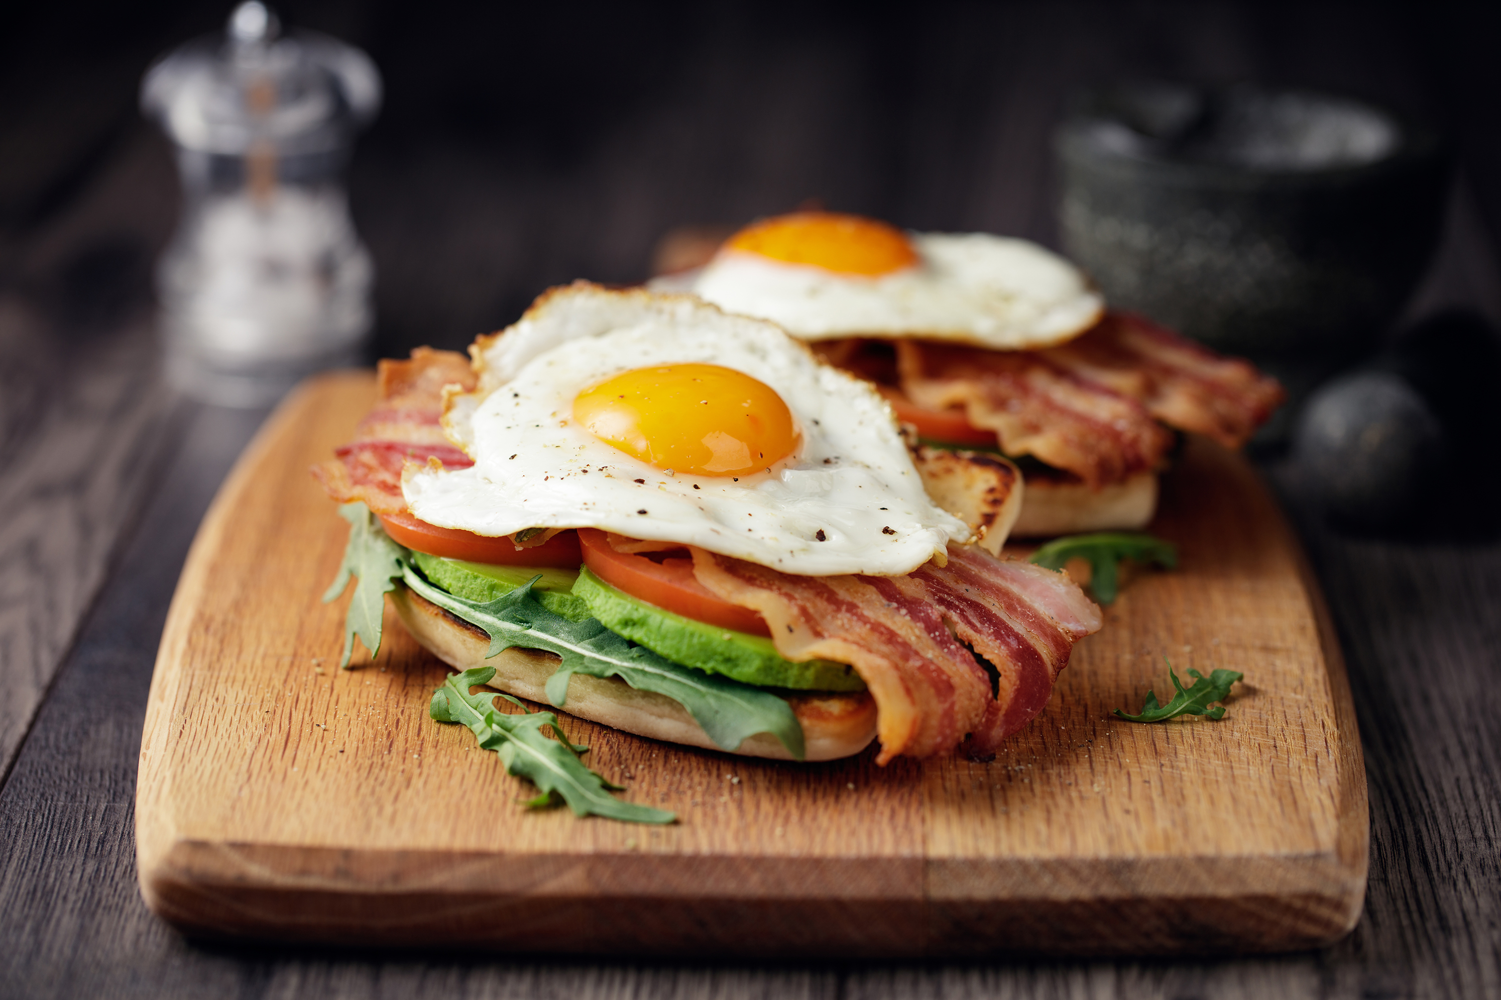
Full Irish Breakfast
€12pp
Available on request only, single sitting, groups of 30 or more.
Includes Sausage, Bacon, Egg, White & Black Pudding, Hash Brown & Beans
Toast
Porridge
Tea & Coffee
PUGIN HALL MAYNOOTH, SOUTH CAMPUS, ST PATRICK'S PONITIFICAL UNIVERSITY , MAYNOOTH, CO KILDARE W23 TW77
PH: +353 1 7083602
EMAIL: catering@spcm.ie
https://cateri78.wixsite.com/puginhallmaynooth

Slide 4

Coffee breaks
Freshly Brewed Tea or Coffee €3.45
Tea, Coffee & Biscuits €4.30
Tea/Coffee Scones (or mini scones) €5.30
Tea/Coffee/Traybakes €6.50
Tea, Coffee & Danish Pastries (large, or mini x 2) €5.30
Biscuits €1.15
Scones, Butter & Jam €2.75
Mini Danish Pastries (2) or Large Danish Pastries (1) €2.75
PUGIN HALL MAYNOOTH, SOUTH CAMPUS, ST PATRICK'S PONITIFICAL UNIVERSITY , MAYNOOTH, CO KILDARE W23 TW77
PH: +353 1 7083602
EMAIL: catering@spcm.ie
https://cateri78.wixsite.com/puginhallmaynooth

Slide 5
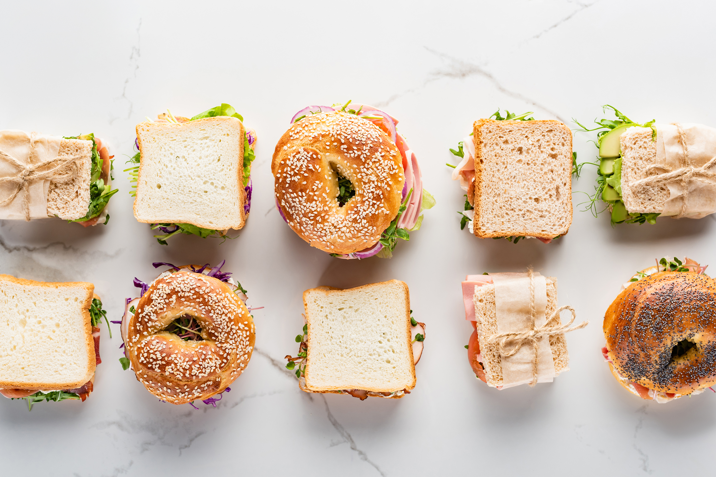
Gourmet Sandwiches
€2.50 Supplement per person
(suitable for events in Pugin Hall or Renehan Hall only, minimum 25, maximum 100)
Soup ‘n Sandwiches
Sandwiches (wedge), Tea & Coffee €10
Sandwich €6.95
Soup, Sandwiches (wedge), Tea, Coffee €11.70
Soup, Sandwiches (wedge), Tea, Coffee with Biscuits €12.20
Roast Vegetable & Garlic Hummus Wrap
Buffalo Mozzarella, Parma Ham, Basil Pesto, Crispy Roll
Open Cranberry, Pecan & Chicken Salad
Mortadella, Tomato Salsa, Pesto Mayo & Ciabatta
Coronation Chicken, Red Onion, Tomato, Mango Chutney Roll
PUGIN HALL MAYNOOTH, SOUTH CAMPUS, ST PATRICK'S PONITIFICAL UNIVERSITY , MAYNOOTH, CO KILDARE W23 TW77
PH: +353 1 7083602
EMAIL: catering@spcm.ie
https://cateri78.wixsite.com/puginhallmaynooth

Slide 6
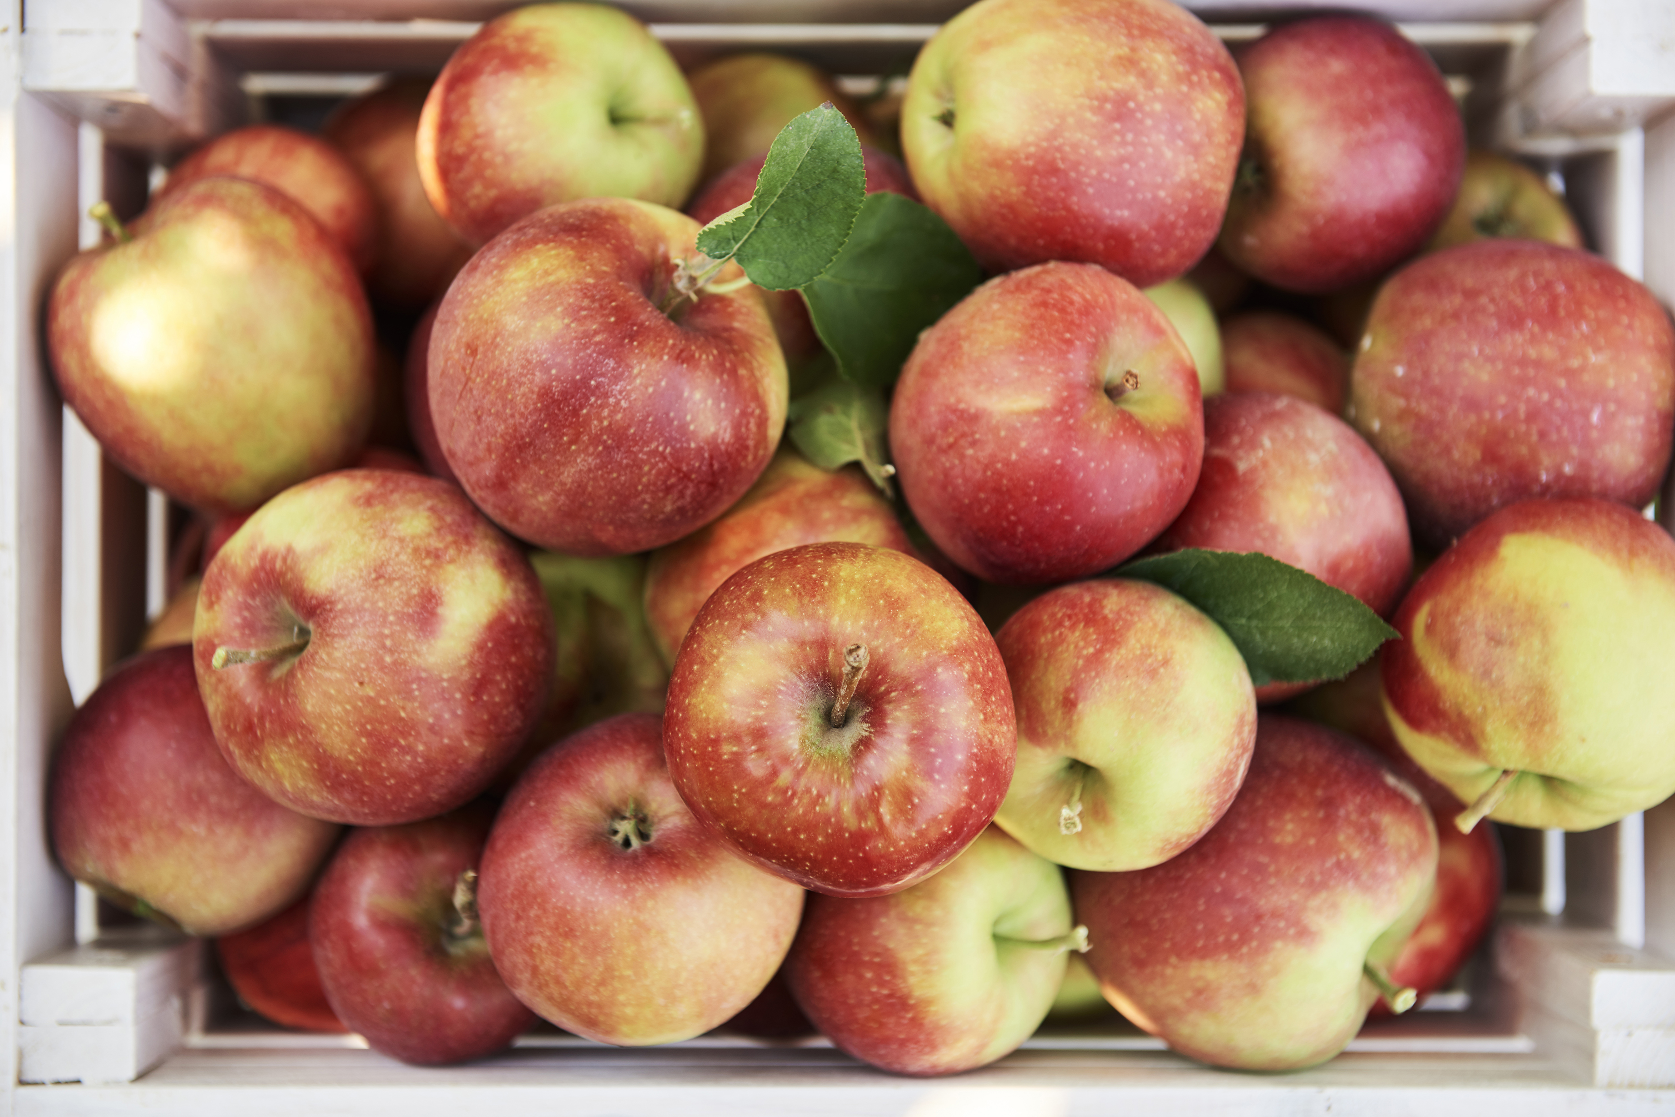
Packed Lunches (Take-away prices)
“Pick and Mix” your own selection from the following;
Sandwich/ Wrap €5.35
Salad Bowls €8*
Vit Hit Bottles €3.60 (Including 15c government deposit)
Can of Mineral €2.30 (including 15c government depos
Glass Water 500mls still/sparkling €2.20
Plastic Water 500mls still/sparkling €2.35 (including 15c government deposit)
Fresh Fruit €1
Cereal Bar €1.80
Muffin €2.55
Crisps €1.80
Chocolate snack bar €1.80
Biscuit pack €1.00
Sliced Brown Bread (2), Butter & Jam €1.40*
•*Not available for groups over 50
PUGIN HALL MAYNOOTH, SOUTH CAMPUS, ST PATRICK'S PONITIFICAL UNIVERSITY , MAYNOOTH, CO KILDARE W23 TW77
PH: +353 1 7083602
EMAIL: catering@spcm.ie
https://cateri78.wixsite.com/puginhallmaynooth

Slide 7
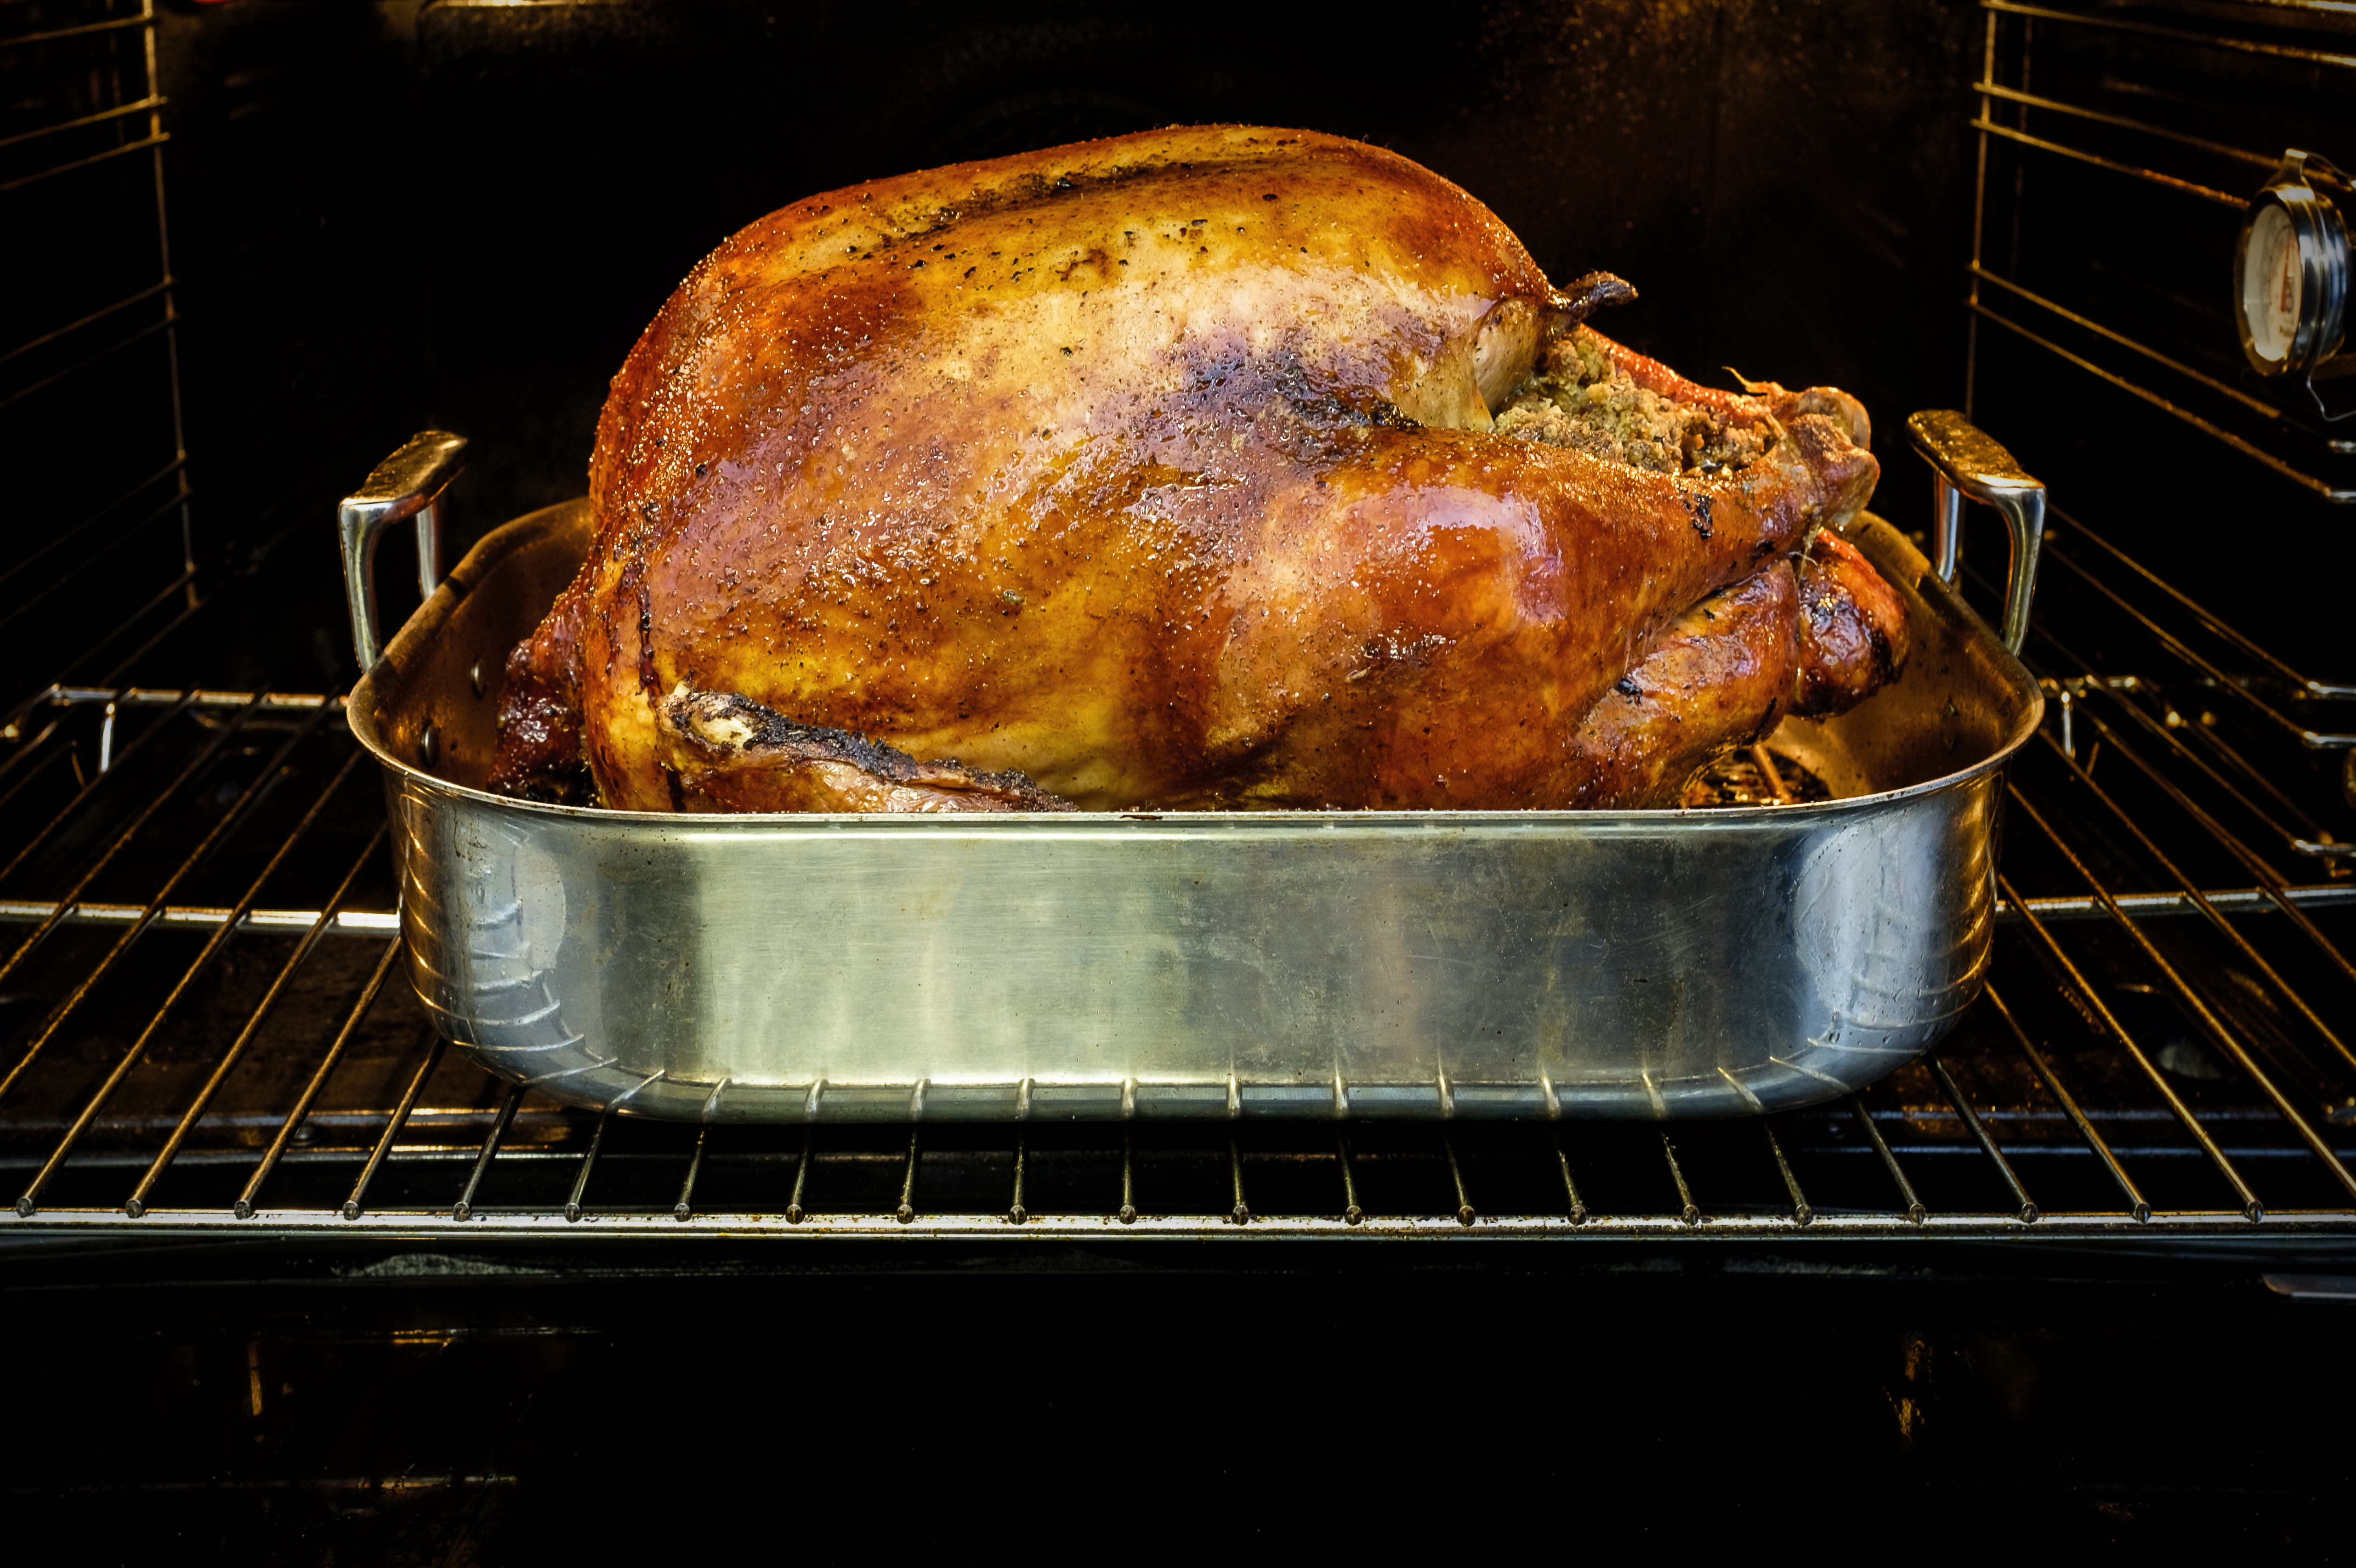
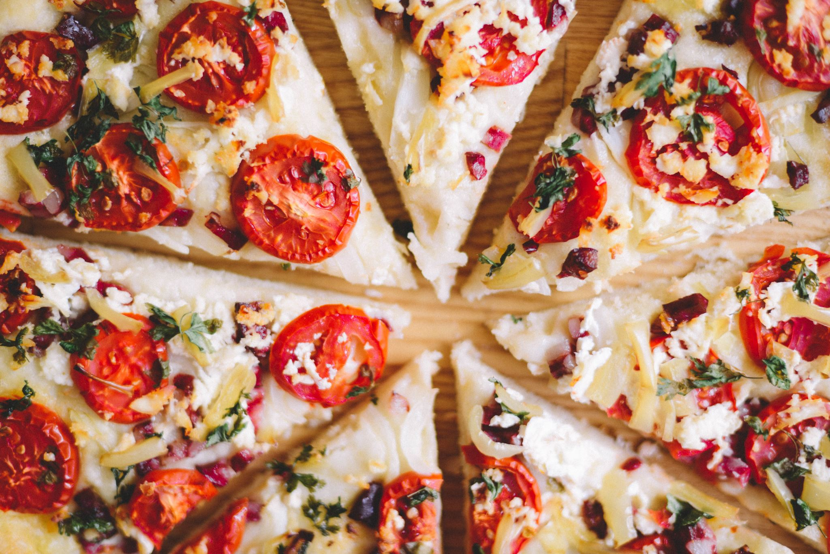
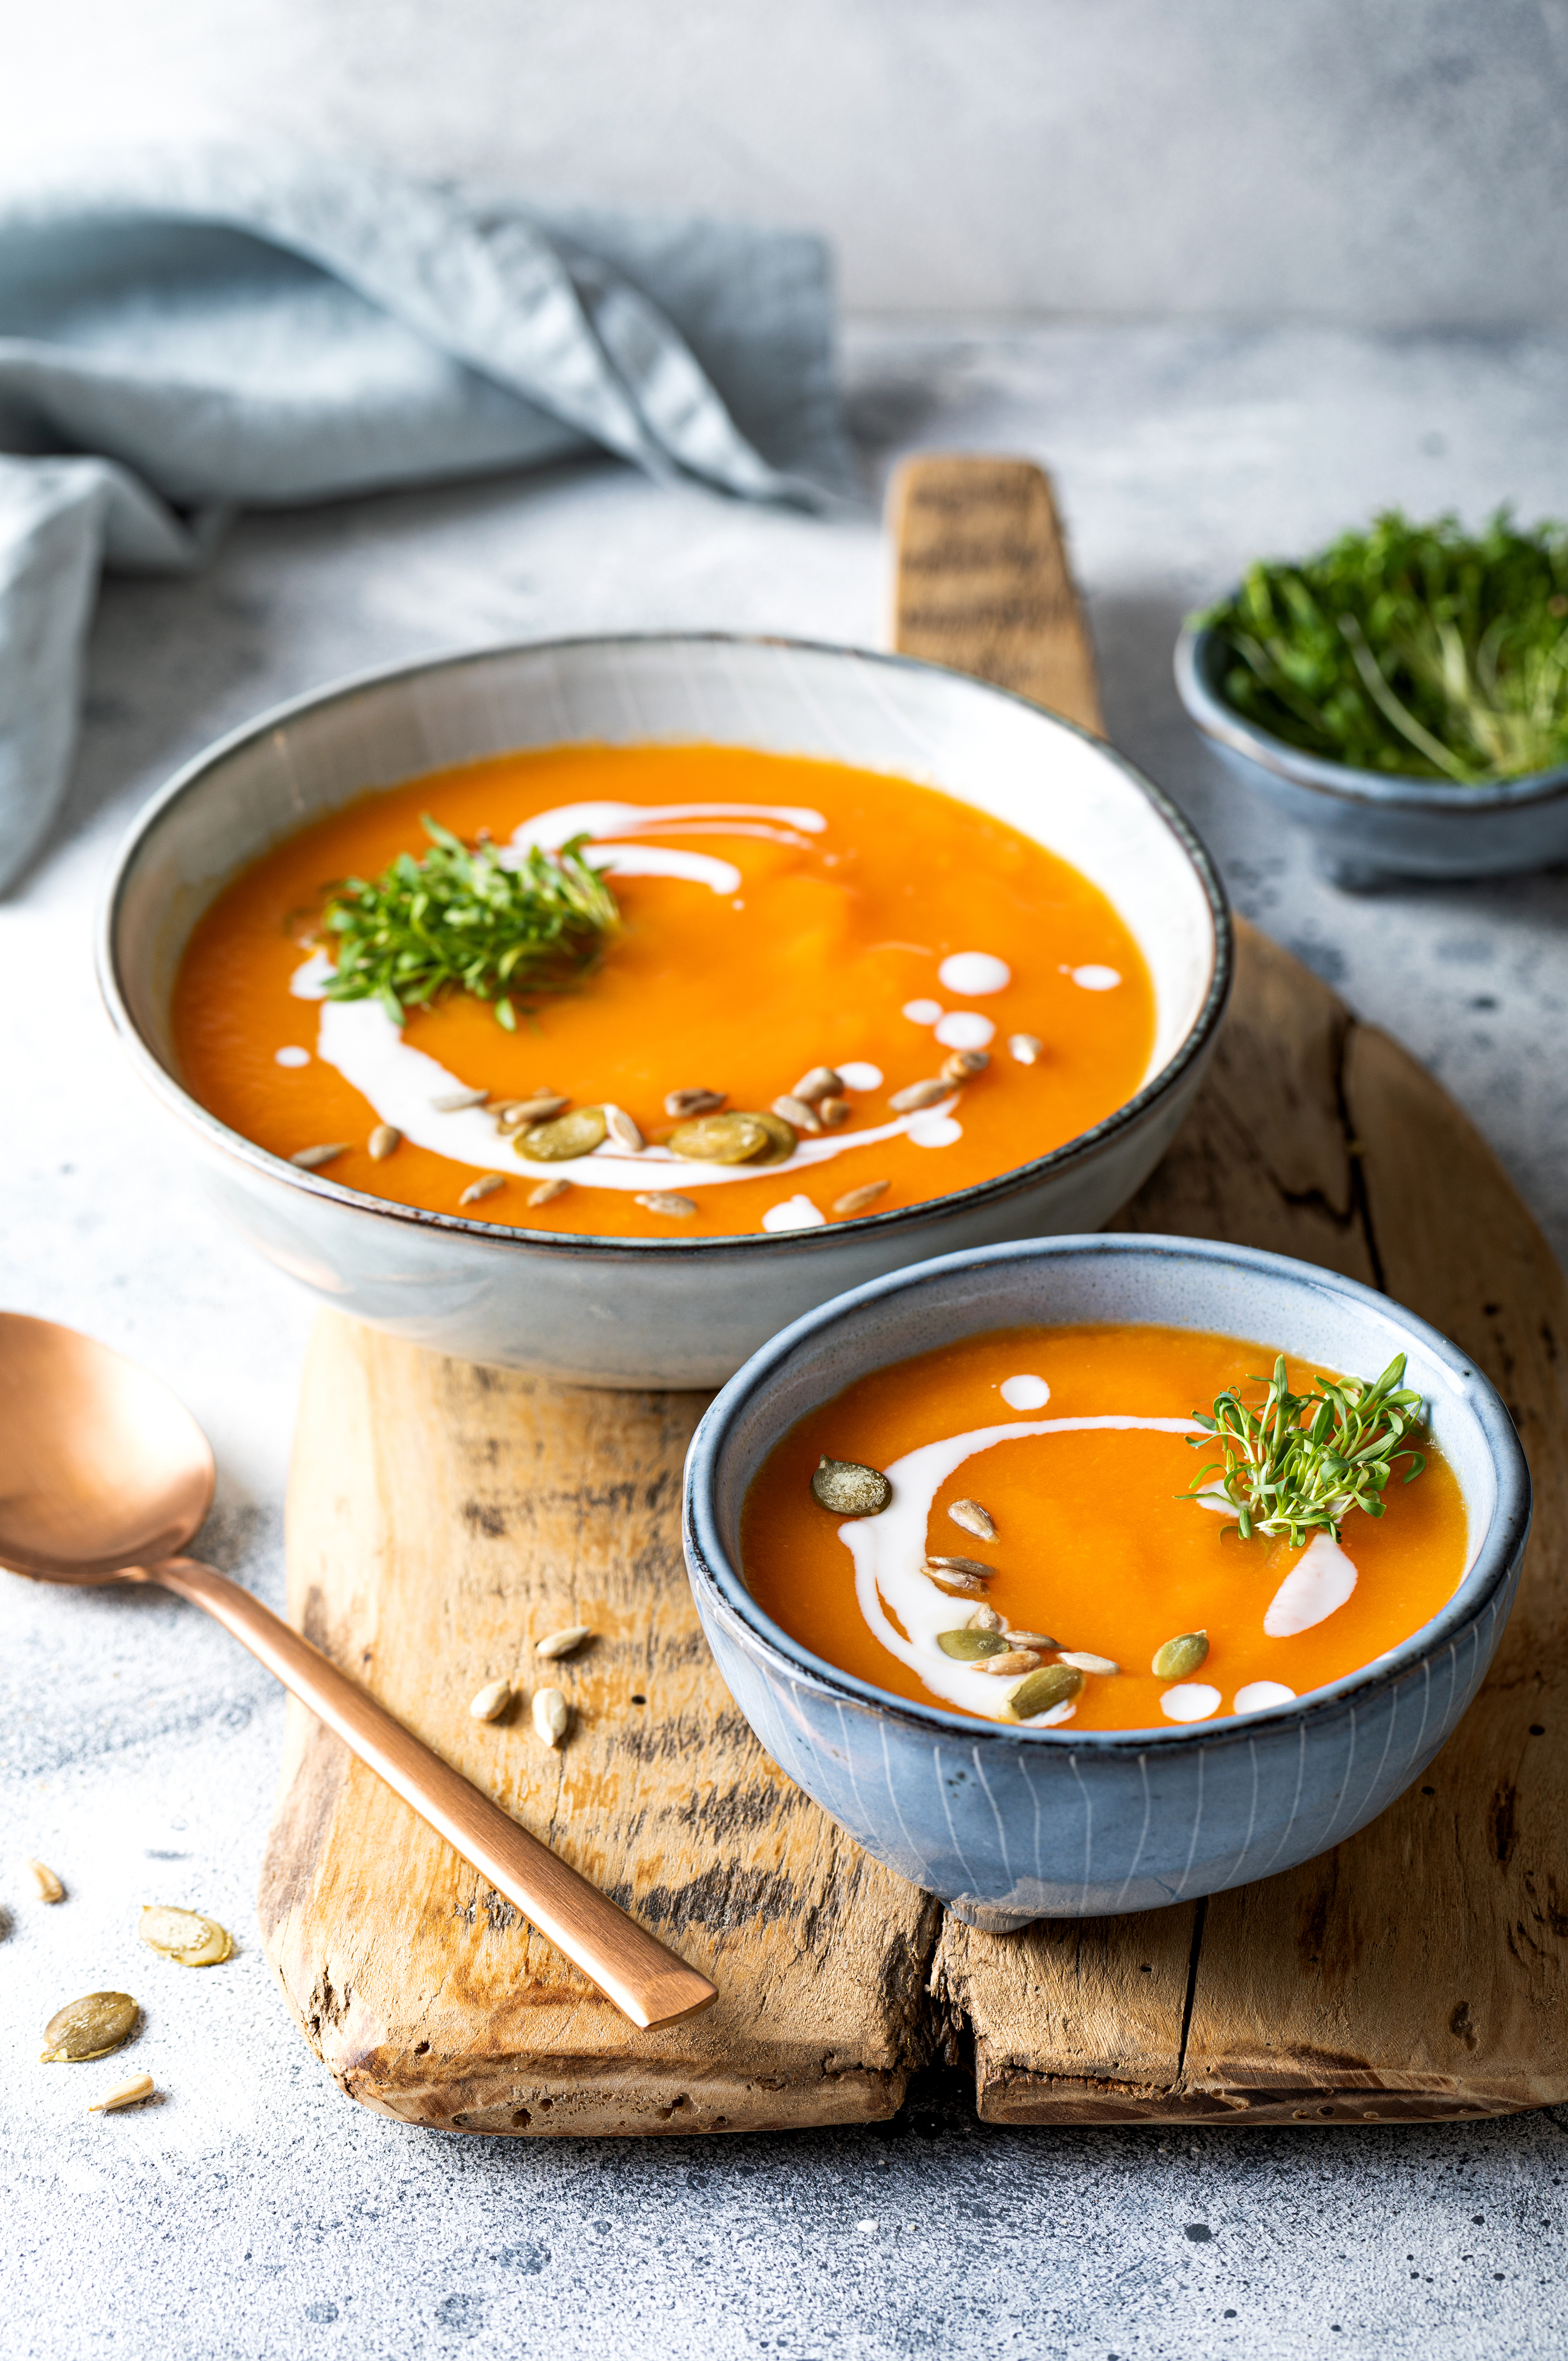
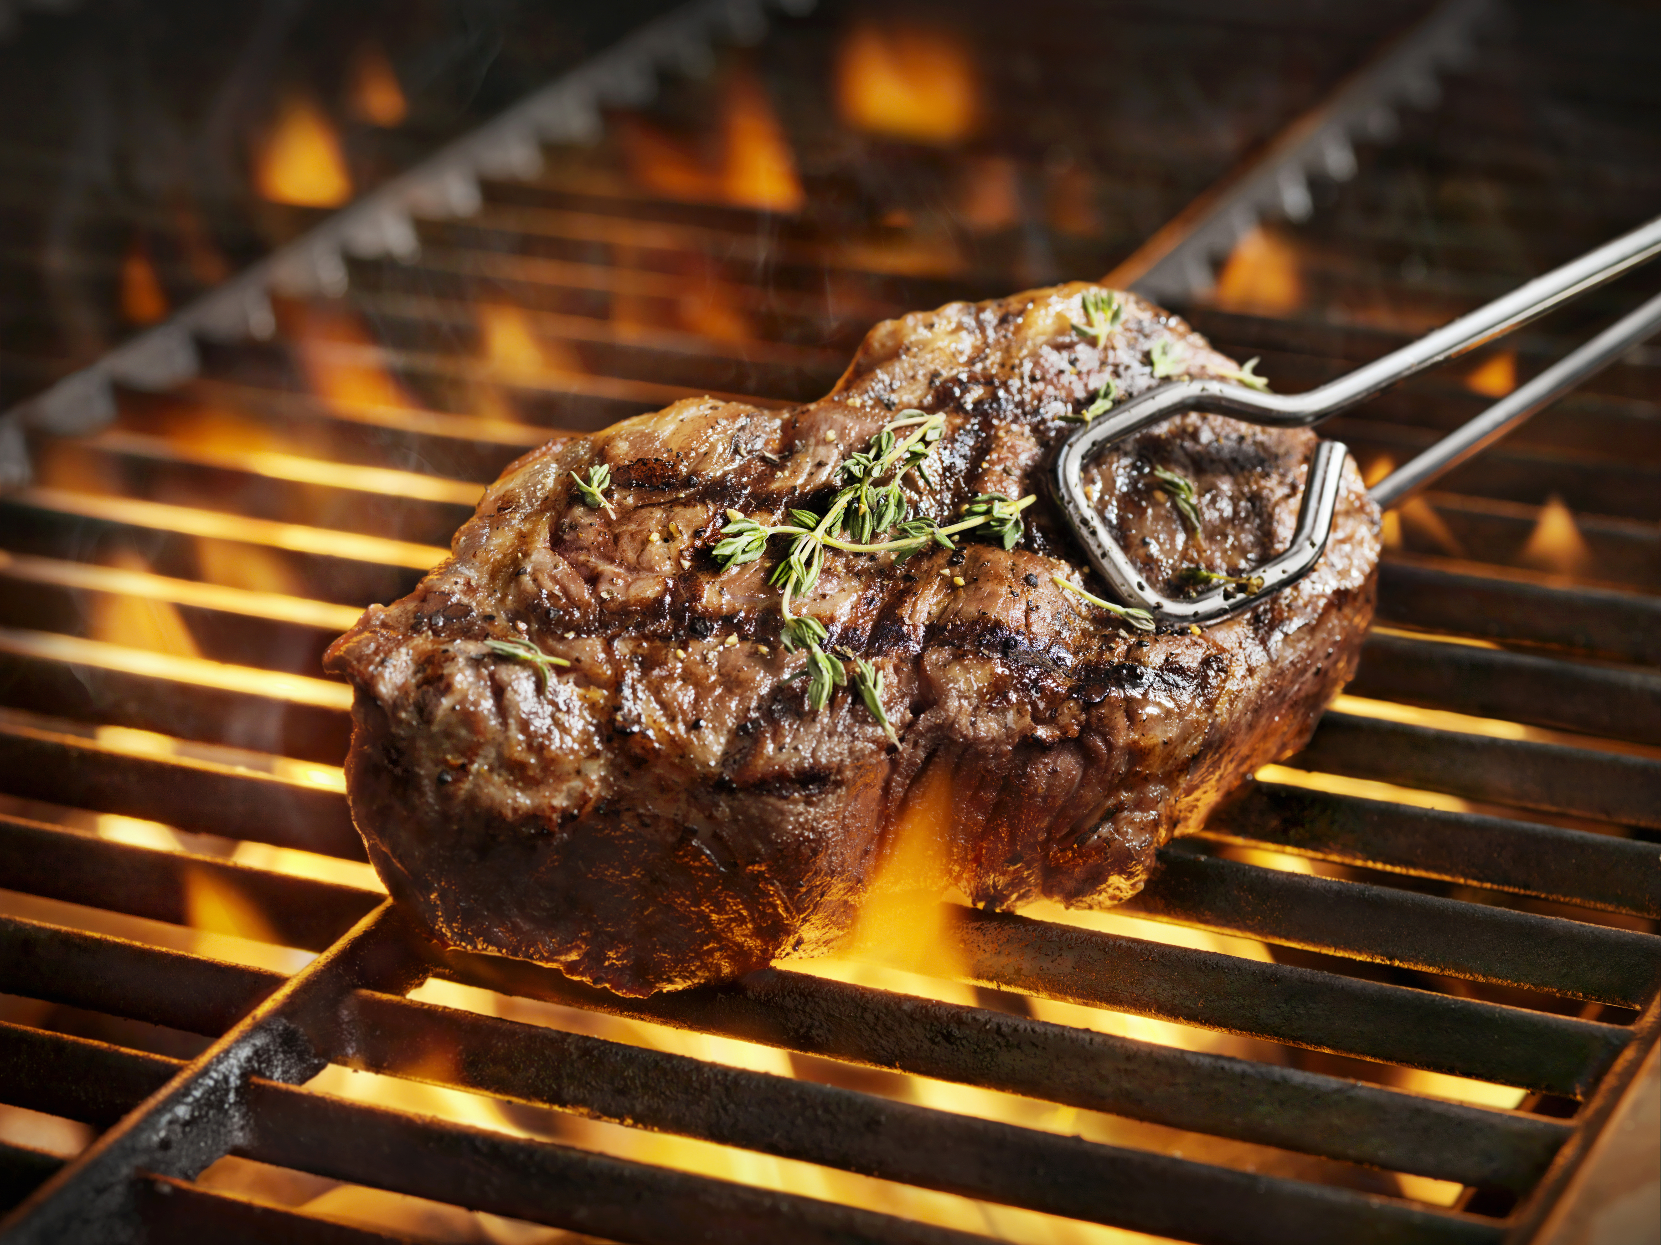
Self-Service Lunches
Lunch is served in the Pugin Hall from 12pm-2pm, Monday to Friday during the academic year. A wide variety of foods are on offer, from roast joints, vegetarian/vegan options, snack bar, prepacked salads & sandwiches.
Your guests are welcome to join us, and we can happily reserve tables for you. See our menus advertised daily on Instagram and Facebook @puginhallmaynooth
We can also provide self- service meals on evenings or weekends, with prior arrangement, subject to a minimum number of 30.
Soup and Roll €4.25
Main Course €12.80
Dessert €4.80
Snack (Goujons or Spring Rolls with Chips and Curry Sauce) €6.50
PUGIN HALL MAYNOOTH, SOUTH CAMPUS, ST PATRICK'S PONITIFICAL UNIVERSITY , MAYNOOTH, CO KILDARE W23 TW77
PH: +353 1 7083602
EMAIL: catering@spcm.ie
https://cateri78.wixsite.com/puginhallmaynooth

Slide 8
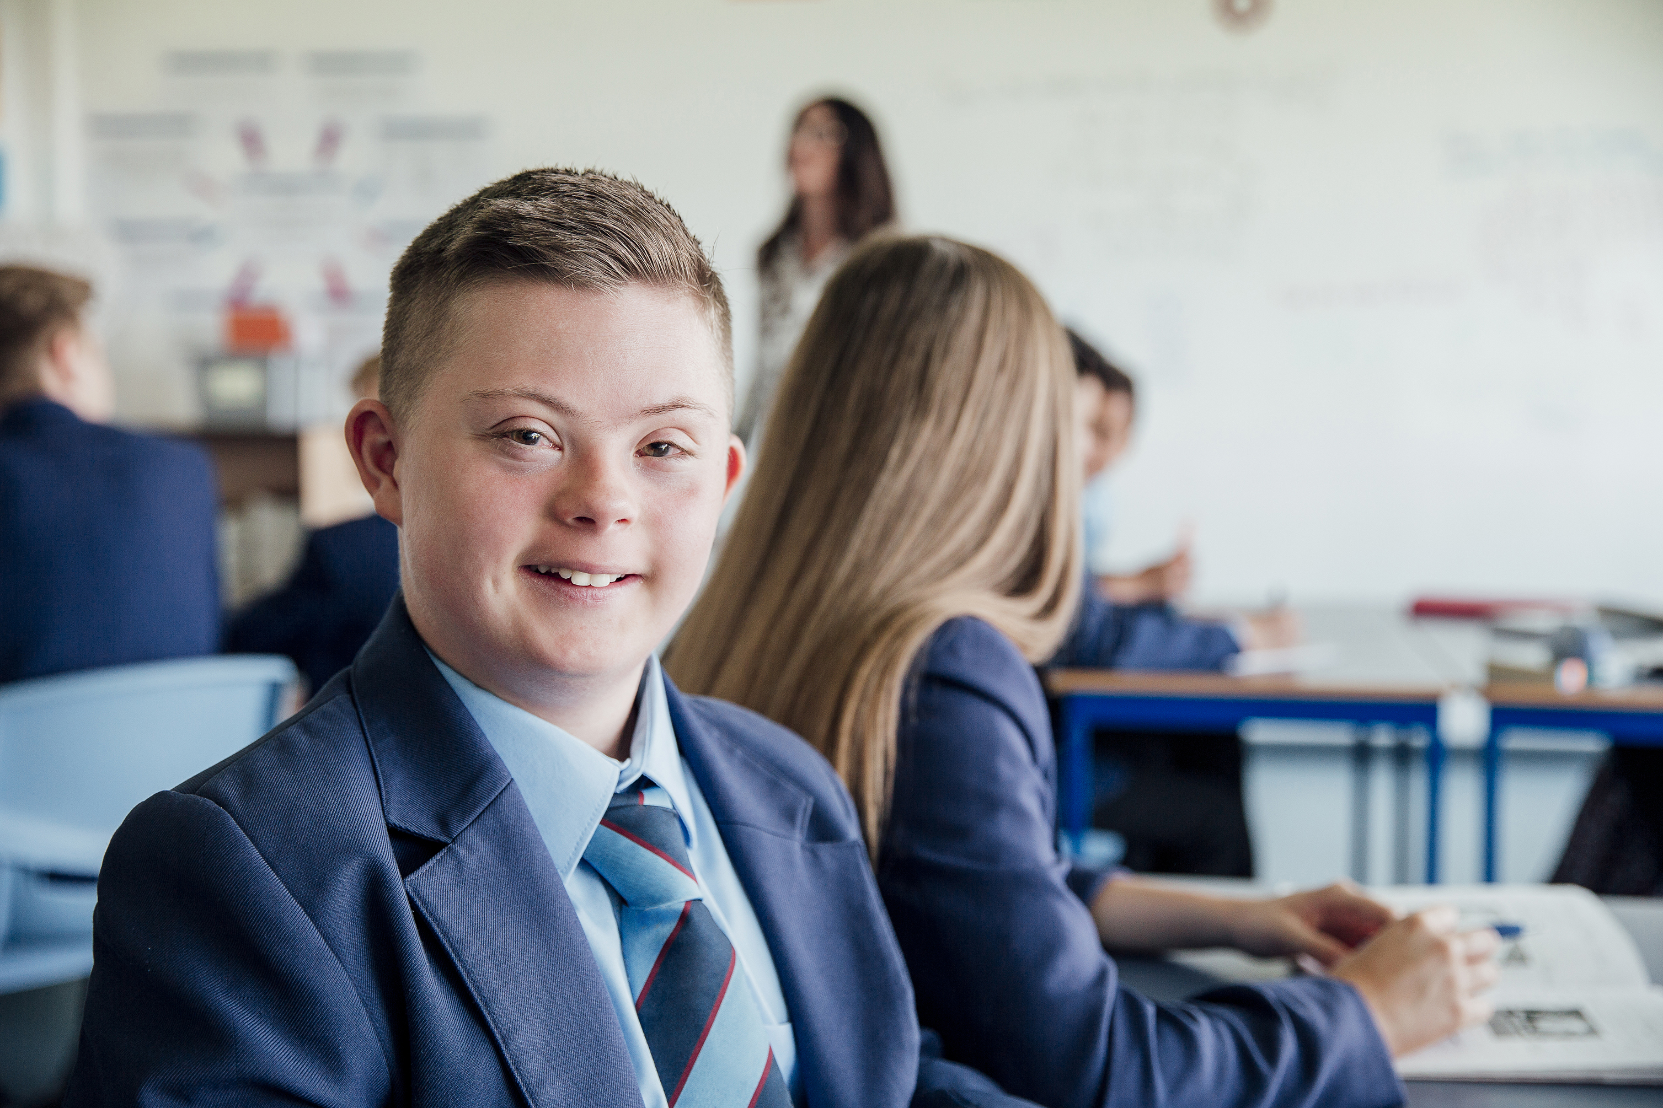
Student Lunches
Designed exclusively for school children or students, during the academic year
€8 Option
Homemade Chicken Goujons Or Spring Rolls & Chips
Can of Mineral
€10.60 Option
Homemade Soup & Sandwiches
Tea or Coffee
€11.75 Option
Thai Green Chicken Curry with Rice
Tea, Coffee or Mineral
€14.90 Option
Spaghetti Bolognese
Tea, Coffee or Mineral and Muffin
€20.30 Option
Homemade Soup & Roll
Joint of the day
Roast Potatoes & Seasonal Vegetables
Gateaux
Tea, Coffee or Mineral
PUGIN HALL MAYNOOTH, SOUTH CAMPUS, ST PATRICK'S PONITIFICAL UNIVERSITY , MAYNOOTH, CO KILDARE W23 TW77
PH: +353 1 7083602
EMAIL: catering@spcm.ie
https://cateri78.wixsite.com/puginhallmaynooth

Slide 9
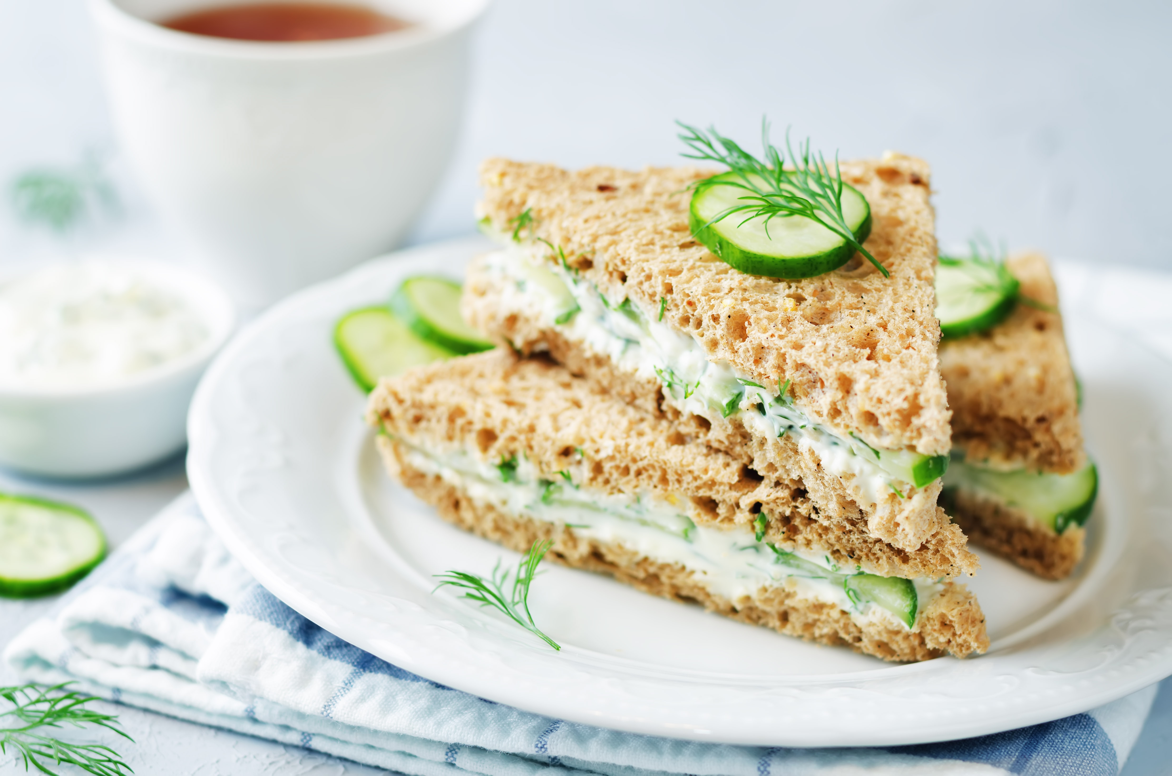

Finger Food Receptions
Minimum 30 guests for all options listed on this page.
No substitutions, but you can add on an additional item for €4
Classic Menu €8.55pp
Cocktail Sausages
Vegetable Spring Rolls
Chicken Goujons
Cold Canapé Menu €12.85pp
Pineapple & Gluten Free Chorizo Skewers
Hoisin Duck & Cucumber on Crispy Italian Bread
Bruschetta with Cherry Tomato & Nut Free Basil Pesto
Bite sized Sandwiches (half round per person
Savoury & Sweet Menu €21.30pp
Pineapple & Gluten Free Chorizo Skewers
Hoisin Duck & Cucumber on Crispy on Crisp Italian Bread
Bruschetta with Cherry Tomato & Nut Free Basil Pesto
Bite Size Sandwiches (Half round per person)
Vegan Carrot Cake Traybake
Mini Lemon Tartlet
Cheese Platter €3.75 per person
Antipasto Platter with Bread Selection (for 10 guests) €50
Ice-Cream Tubs €2.30
PUGIN HALL MAYNOOTH, SOUTH CAMPUS, ST PATRICK'S PONITIFICAL UNIVERSITY , MAYNOOTH, CO KILDARE W23 TW77
PH: +353 1 7083602
EMAIL: catering@spcm.ie
https://cateri78.wixsite.com/puginhallmaynooth

Slide 10
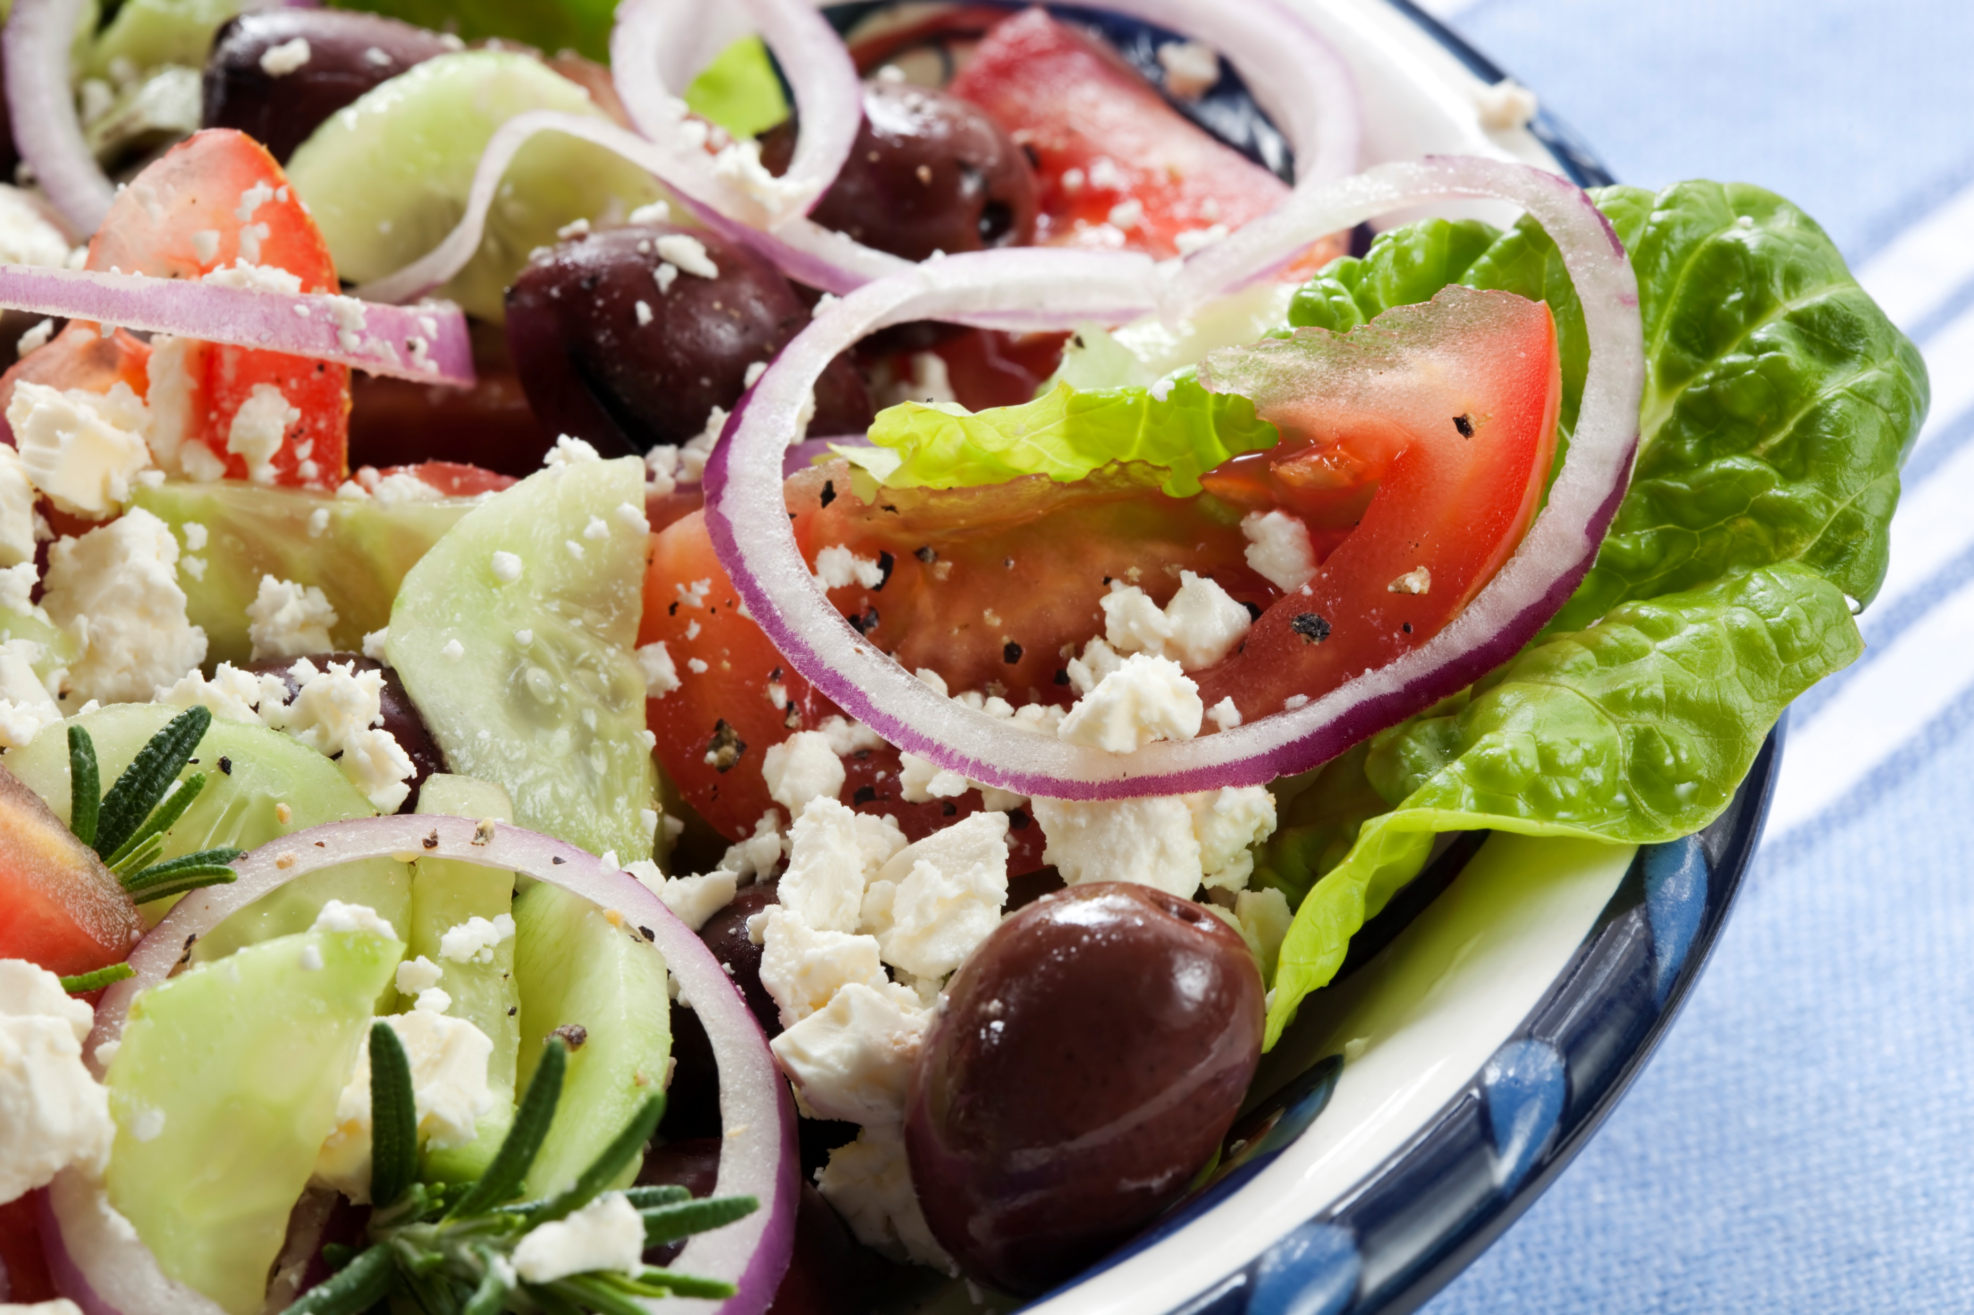
Formal Buffet
Minimum of 30 guests, and two food courses with tea and coffee
Tables will be fully set and dressed, with filtered still tap water.
Starter Options
As the starter option is already on the table when your guests arrive, please choose one starter only. Dietary requirements outside of your chosen can be looked after on an individual basis
Melon Balls with Fresh Mint and Orange Segments - €7
Roast Vegetable & Tomato Salad - €8.50
Smoked Duck with Beetroot & Orange Segments, Red Onion Croutons & Radicchio €9
Smoked Salmon, Creamed Horseradish, Mini Capers & Peppered Rocket - €9
Baked Baby Crotin, Crispy Proscuitto, Chilli Jam, Crème Fraiche & Micro Cress €10
Kilmore Quay Crab & Prawn Cocktail, Avocado Mousse, Brandy Marie Rose - €11.70
PUGIN HALL MAYNOOTH, SOUTH CAMPUS, ST PATRICK'S PONITIFICAL UNIVERSITY , MAYNOOTH, CO KILDARE W23 TW77
PH: +353 1 7083602
EMAIL: catering@spcm.ie
https://cateri78.wixsite.com/puginhallmaynooth

Slide 11
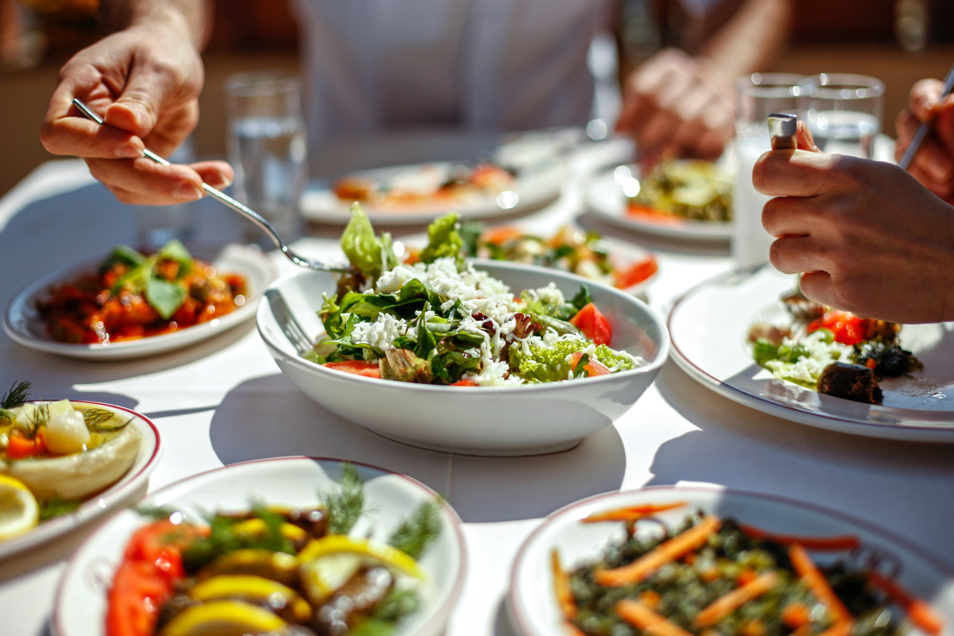
Formal Buffet
Main Course Options
(Please note that you must have a minimum of 30 guest for each choice, maximum of three choices in total. Dietary requirements outside of your chosen dish can be looked after on an individual basis)
Butter Chicken with Pilaf Rice, Coriander Naan €13.90
Classic Beef Stroganoff & Rice €13.90
Butternut Squash & Spinach Curry & Rice €13.90
Spiced Sticky Tofu with Stir Fried Vegetables, Sesame Seeds & Rice €13.90
Chicken Breast Wild Mushroom Sauce, Spring Onion Mash & Mixed Peppers €20
Irish Beef & Guinness Stew with Champ Potatoes €18.20
Tuscan Chicken Thighs, with Double Cream, Spinach, Paprika& Parmesan Sauce, served with Rice €13.90
Fish Pie, topped with Duchesse Potatoes & Broccoli Spears €18.20
The following are €30 each, but may change depending on market prices at time of ordering
Shank of Lamb, Slow cooked in Red Wine & Rosemary, Colcannon & Savoy Cabbage €30
Roast Fillet of Beef, Pink Peppercorn Sauce Spring Onion Mash & Chunky Honied Carrots €30
Steamed Seabass with Saffron Sauce, Asparagus & Peppers, Baby Roast Potatoes €30
Minimum of 30 guests, and two food courses with tea and coffee.
Minimum 30 portions per choice
Tables will be fully set and dressed.
PUGIN HALL MAYNOOTH, SOUTH CAMPUS, ST PATRICK'S PONITIFICAL UNIVERSITY , MAYNOOTH, CO KILDARE W23 TW77
PH: +353 1 7083602
EMAIL: catering@spcm.ie
https://cateri78.wixsite.com/puginhallmaynooth

Slide 12
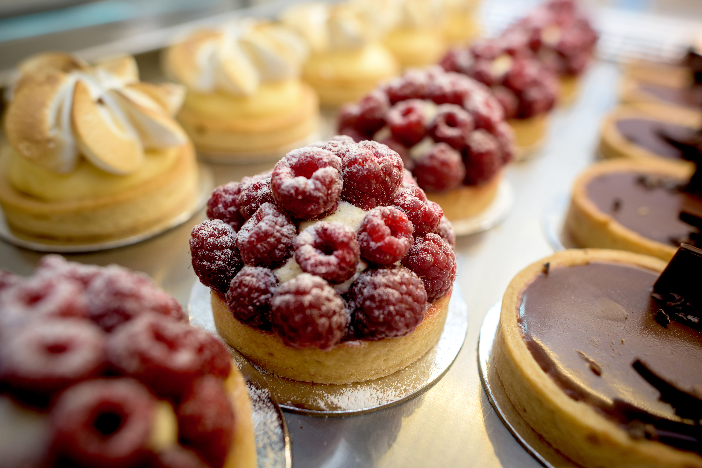
Buffet
Dessert Options will be served buffet style, minimum 30 portions per choice, up to a maximum of three choices
Raspberry Frangipane (vegan & gluten free) €7
Pear and Almond Tart €7
Irish Cream Liqueur Cheesecake €7
Sticky Toffee & Hazelnut Pavlova (gluten free) €7
Chocolate Fudge Gateau with Whipped Cream €7
Homemade Apple Pie with Fresh Cream €7
Trio of Miniature Desserts €7
Minimum of 30 guests, and two food courses with tea or coffee
Tables will be fully set and dressed.
PUGIN HALL MAYNOOTH, SOUTH CAMPUS, ST PATRICK'S PONITIFICAL UNIVERSITY , MAYNOOTH, CO KILDARE W23 TW77
PH: +353 1 7083602
EMAIL: catering@spcm.ie
https://cateri78.wixsite.com/puginhallmaynooth

Slide 13
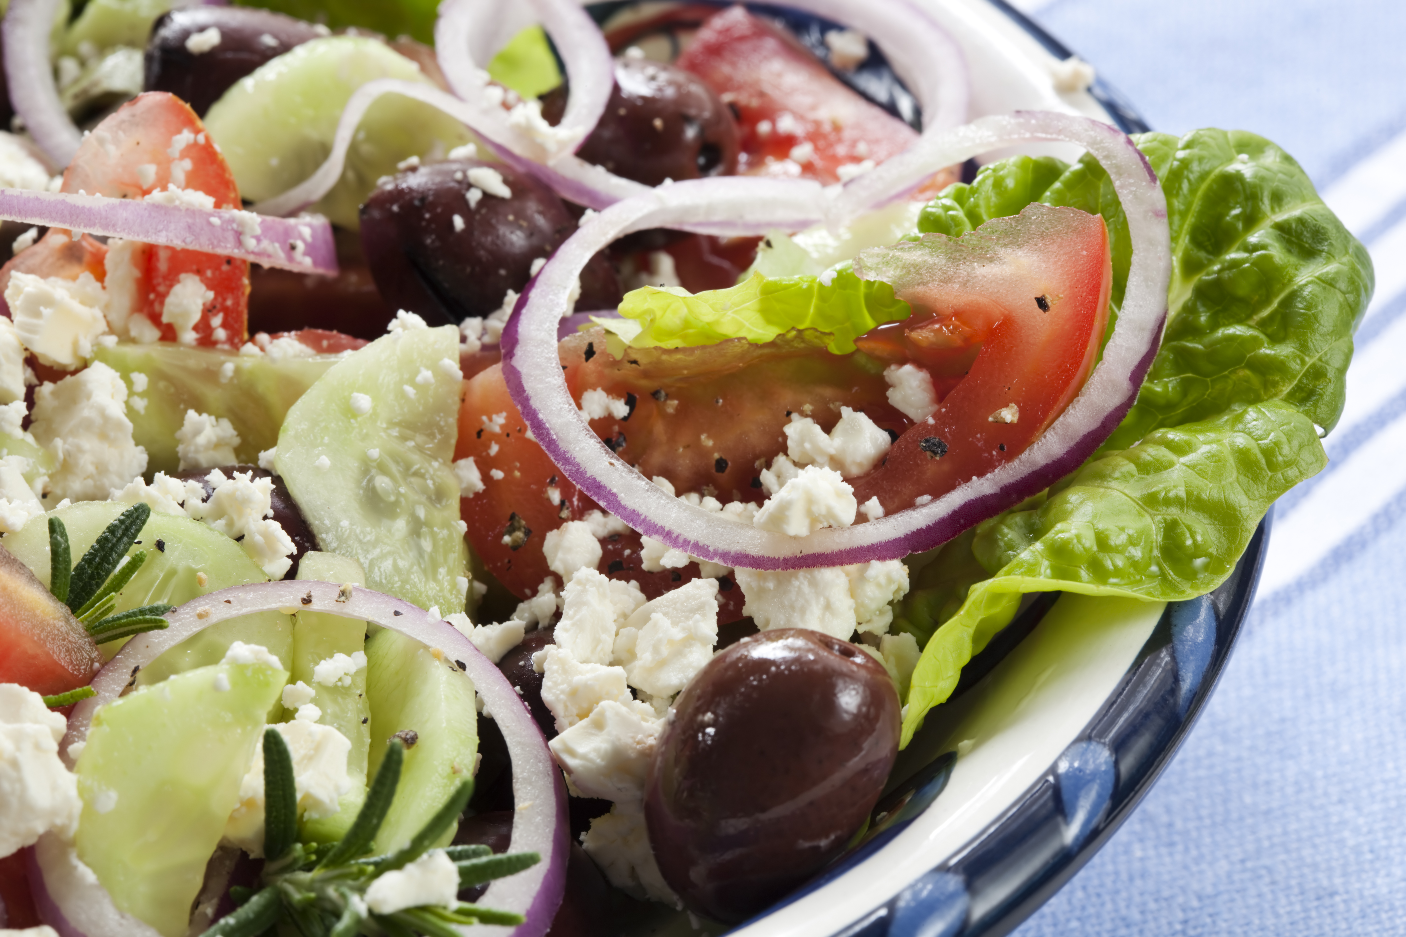
Large Salad Bowls
Broccoli, Feta Hazelnut & Cherry Tomato
Protein Bowl of Beans, Chickpeas, Sweetcorn, Coriander & Lime Dressing
Asparagus, Pea & Mint Salad
Roast Baby Potato with Whole Grain Mustard
Baby Mozzarella, Sweet Peppers, Red Onion, Tomato, Cucumber & Reduced Balsamic
Bread Rolls
Petit Pain & Butter €1.65 each
Brown Bread Portion & Butter (2 per person) €1.65
€44 each
(approximately 15 portions per bowl)
PUGIN HALL MAYNOOTH, SOUTH CAMPUS, ST PATRICK'S PONITIFICAL UNIVERSITY , MAYNOOTH, CO KILDARE W23 TW77
PH: +353 1 7083602
EMAIL: catering@spcm.ie
https://cateri78.wixsite.com/puginhallmaynooth

Slide 14

Drinks
House Wine €24.50 per bottle
Prosecco €24.50 per bottle
Corkage €8.75 per bottle
Tea/Coffee €3.45
Jugs of Juice €12.75 per bottle
Purezza Filtered Tap Water €1.60 per bottle (700ml) (Available for Pugin/Renehan Hall only)
Vit Hit Bottles €3.60 (Including 15c government deposit)
Can of Mineral €2.30 (including 15c government depos
Glass Water 500mls still/sparkling €2.20
Plastic Water 500mls still/sparkling €2.35 (including 15c government deposit)
PUGIN HALL MAYNOOTH, SOUTH CAMPUS, ST PATRICK'S PONITIFICAL UNIVERSITY , MAYNOOTH, CO KILDARE W23 TW77
PH: +353 1 7083602
EMAIL: catering@spcm.ie
https://cateri78.wixsite.com/puginhallmaynooth

Slide 15
Terms and Conditions
All bookings must be confirmed within two weeks of initial enquiry in writing to events@mu.ie or catering@spcm.ie.
Cancellation of catering bookings must be made in writing to catering@spcm.ie two full working days prior to the date of the function. If a lunch or dinner is cancelled, a fee of 25% of the total food costs, or costs incurred to the date of the cancellation will apply.
Notification of menu and beverage selection is required two weeks prior to the function .Final numbers are required three working days prior to the function. This attendance figure will be considered as the guaranteed number of attendees and will be the minimum charged.
For events in Pugin Hall, unless there has been a prior arrangement made, the hall must be vacated one hour after the final course has been served. Seating arrangements may be planned to suit your requirements.
As Pugin Hall is primarily the dining facility for resident seminarians, permission is required for certain events. Please contact the catering manager for further details.
Nothing is to be nailed, screwed, stapled or adhered to any wall, door or other surface or part of the building.
The organiser of the function is financially responsible for any damage sustained as a result of the function being held.
All food and beverages consumed on the premises must be supplied by the catering department, (with the exception of a ‘bring your own wine’ facility, when a corkage fee of €8.75 will be charged per bottle).
For internal university departments, a booking will not be guaranteed without submitting a business unit number.
Flowers/ microphones/ podium stands etc may be arranged separately. Please ask for assistance.
The brochure is a guide to menu options available. Should you have specific requests/ ideas in relation to your function, please let us know and we will be glad to assist where possible. Substitutions may be made to the menu, depending on seasonal availability.
PUGIN HALL MAYNOOTH, SOUTH CAMPUS, ST PATRICK'S PONITIFICAL UNIVERSITY , MAYNOOTH, CO KILDARE W23 TW77
PH: +353 1 7083602
EMAIL: catering@spcm.ie
https://cateri78.wixsite.com/puginhallmaynooth

